Slide 1
The Principles of Opportunity Cost and Diminishing Returns
Ana Hoerner Salt Lake Community College Spring 2017 ECON 2010-008

Slide 2
Opportunity Cost
The alternative cost, or the value of the next best thing.
Notes:
Opportunity cost is the alternative cost, or the value of the next best mutually exclusive choice made.

Slide 3
Should I rent or buy?
Notes:
In early 2016 I was renting a duplex for $1100. Rent was about to go up by $200 a month, and we thought that was too much. So, I calculated the opportunity costs of renting vs buying a house in the same neighborhood. I did the math.

Slide 4
To rent…
Cost to continue renting:
$1300 x 12 months = $15,600
And one thing became clear:
Notes:
I calculated the sunk costs of renting for 1 year. This part was easy: simply multiply the cost of rent by 12 months. I discovered that it would cost us $15,600 to continue living in this duplex for another year.

Slide 5
You vs. the house she told you not to worry about.
Notes:
The opportunity cost of buying the house down the road from the duplex would be more complicated to calculate, but I persevered. We did not make a down payment, and we used a VA Loan, so we did not have mortgage insurance attached to our loan, and pretty soon one option became more attractive than the other.

Slide 6
$$Principal+\left(Principal ×Interest\right)−Payment=New Principal Balance…$$
 | Principal | Percent Interest $\frac{3.75\%}{12}$ | Accrued Interest | Payment
April | $ 275,000.00 | 0.003125 | 859.375 | $ 1,348.25
May | $ 274,511.13 | 0.003125 | 857.8472656 | $ 1,348.25
June | $ 274,020.72 | 0.003125 | 856.3147571 | $ 1,348.25
July | $ 273,528.79 | 0.003125 | 854.7774594 | $ 1,348.25
August | $ 273,035.31 | 0.003125 | 853.2353578 | $ 1,348.25
September | $ 272,540.30 | 0.003125 | 851.688437 | $ 1,348.25
October | $ 272,043.74 | 0.003125 | 850.1366821 | $ 1,348.25
November | $ 271,545.62 | 0.003125 | 848.580078 | $ 1,348.25
December | $ 271,045.96 | 0.003125 | 847.0186095 | $ 1,348.25
January | $ 270,544.72 | 0.003125 | 845.4522614 | $ 1,348.25
February | $ 270,041.93 | 0.003125 | 843.8810185 | $ 1,348.25
March | $ 269,537.56 | 0.003125 | 842.3048654 | $ 1,348.25
 |  |  | 10210.61179
Notes:
First, I calculated the interest we would pay on the mortgage in the first year by multiplying the starting principal balance by the (interest rate over 12), which gave me the amount of interest accrued on that principal. Then I added the starting principle balance and the accrued interest, and subtracted my monthly payment, which gave me the second month’s principal. And so forth, for 12 months. Then I found the Sum of the 12 interest accruals to arrive at $10,211 in interest paid that first year.

Slide 7
Married Filing Jointly
2016 Tax Computation, no deductions
$\left(\$100,000 ×25\% \right)−\$8,457.50=\$16,543$
2016 Tax Computation, mortgage interest deduction
$\$100,000−\$10,211=\$89,789$
Tax Table for this income level: $13,989
Difference = Savings
$\$16,543−\$13,989=\$2,554$
Notes:
Next, I calculated income tax savings I would get from deducting the mortgage interest. I first figured out what our tax burden would be for our income before the mortgage interest deduction by checking the IRS 1040 tax tables for 2016, and I calculated that in that case my tax burden would be $16,543, again, before any deductions. Then, I subtracted the $10,211 mortgage interest from our income, and arrived at $89,789. Then I checked the tax tables again to find that the tax burden on the new taxable income would be $13,989. Of course, then I found the difference between my original tax burden and the tax burden after mortgage interest deduction, and found that we had saved $2554.

Slide 8
Property Taxes
Notes:
After that, I checked my property tax bill to find that our property tax burden was $2,344.

Slide 9
…or not to rent? That is the question.
Mortgage Interest on $275,000 at 3.75%, 30-year Fixed
Income Tax Savings
Property taxes
Opportunity Cost of Buying
$10,211
$2,554
$2,344
$10,001
Notes:
Then, after all of that, I added my mortgage interest ($10,211), minus income tax savings ($7,076), plus property taxes ($2,344), and found that $10,001 would be our sunk costs of homeownership for the first year.

Slide 10
Buying it is.
Renting at a cost of $15,600 > buying at a cost of $10,001
Compare opportunity costs → make a decision.
Every case is different, so you do the math.
Thank you, VA Loan!
Notes:
Thus, the cost to rent at $15,600 is greater than buying at a cost of $10,001. So, in my case, it was clear that buying was the more advantageous option, because it would cost only two-thirds as much as renting in the same neighborhood. By comparing the opportunity costs of renting vs. buying I figured out that buying was a viable option. And happily, a full year later, I agree with my previous assessment. And thank goodness for VA loans!

Slide 11
Diminishing Returns
Overdoing it, or knowing when to stop.
Notes:
Diminishing returns is used to refer to a point at which the level of profits or benefits gained is less than the amount of money or energy invested.

Slide 12
Diminishing Returns for a firm
After a certain point, it is marginally less profitable for the firm to add another waiter, because the marginal change in patrons served diminishes.
Notes:
Diminishing returns, for a firm, may look like this. Here we have a café limited by the size of its building, the number of tables, and the capacity of their kitchen.
As the café begins adding wait staff, they see a marginal increase in the amount of patrons they can serve.
Until that marginal change in patrons served begins to decrease.
In this example, 3 is the most profitable number of waiters to have on staff, based on the Principle of Diminishing Returns.

Slide 13
Diminishing Returns for the Rest of us
We decide between getting up or sleeping longer,
Eat another serving of your favorite snack or stopping the madness,
Keep studying through the night or get some sleep,
Spend 20 minutes making a proper meal or starve, …
Notes:
Diminishing returns is an interesting principle to study, because as we learn more about it we realize that we encounter it every day and we make decision after decision based on this principle. Should I get up or keep sleeping? Should I eat the entire bag of chips? Would studying through the night benefit me more than going to sleep now? Is having a proper meal worth 20 minutes of my time and effort, or should I skip it?

Slide 14
Diminishing Returns for an Individual
THE NUMBERS
Optimal study time for 1 class:
3 hours
Optimal hours of sleep before exam:
7 hours
Beyond these lengths of time, I gain no benefit.
Notes:
All these decisions can be represented graphically. For example, an approximation can be made for how much I benefit from studying for a given class final, as well as how much I benefit from a certain amount of sleep before the final. Models help us visualize the data, but, in reality, we make these decisions in a snap.

Slide 15
In my life
I often try to do everything, and when I do I stress out so badly that I get anxiety attacks.
Being aware of the principle of diminishing returns is helpful to me in making better day to day decisions.
Learning to recognize when I’m overdoing something would be a valuable, and very relevant, life skill.
Notes:
In my life I usually try to do it all. For example, I am responsible for running my household, I homeschool my three children who all are at different levels, and for some awesome reason I thought that I should go back to school this semester with 17 credit hours, 6 classes. It wasn’t my best idea, if I’m honest. I’m drowning in homework, and never again!
Being aware of the principle of diminishing returns is helpful to me. I now believe, and am keenly aware, that learning to recognize the point when I’m overdoing something is a valuable and very relevant life skill.

Slide 16
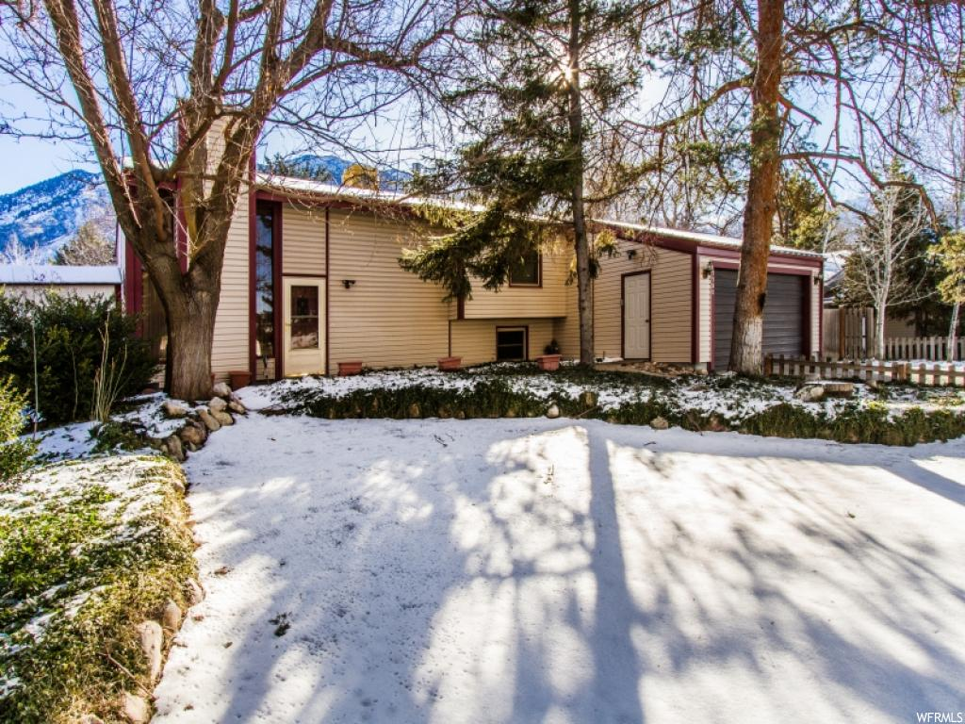
Notes:
This is my home.

Slide 17
Works Cited
U.S. Department of the Treasury, Internal Revenue Service. 1040 Tax Tables 2016. IRS Cat. No. 24327A. Washington: GPO, 2016.
Edward L. Glaeser , and Jesse M. Shapiro , "The Benefits of the Home Mortgage Interest Deduction," Tax Policy and the Economy 17 (2003): -.

